Slide 1
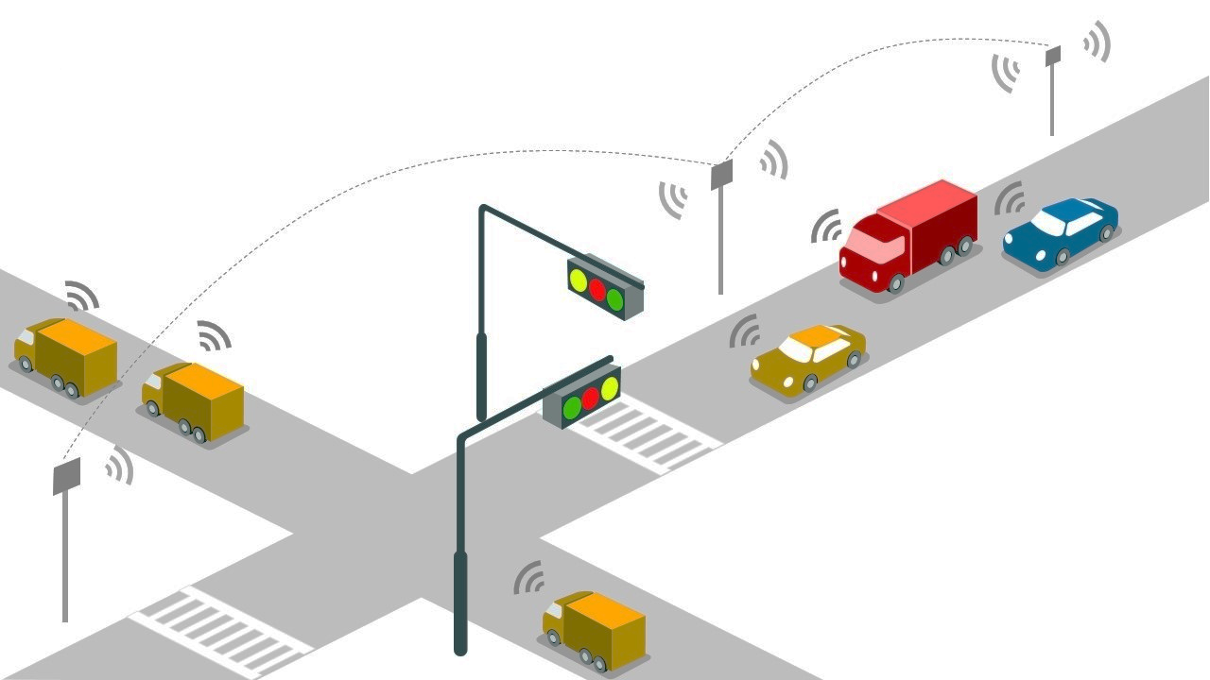

Intelligent Traffic Signal Control System for Emergency Vehicles
DEPARTMENT OF ELECTRICAL AND ELECTRONICS ENGINEERING
COIMBATORE INSTITUTE OF TECHNOLOGY
COIMBATORE.
UNDER THE GUIDANCE OF
Dr. S Vasantharathna
Professor & Head of the Department
Abhishek Shivram A - 1803002
Laleth I N - 1803031
Shaik Azamathulla - 1803055
Sivnandhini S R - 1803056

Slide 2




Problem Statement
Many lives have been lost due to delay in emergency vehicle services which is a result of traffic congestion. The problem is to figure out a way for emergency vehicles to reach the destination on time.
Issues Related To Emergency Transport
Reports On Response Time
Increase In Vehicle Density
Deaths due to Delay In Service

Slide 3

OBJECTIVES
To provide a ‘Green Corridor’
Improving the response time
To provide a route without affecting the normal traffic flow
Reduced time and fuel consumption
Pushing conventional traffic system a step ahead

Slide 4



EXISTING SYSTEMS
Fixed timer control
Adaptive timer control
Automation using RFID
Image processing
Using sensors – Bangalore –
JICA

Slide 5
LITERATURE SURVEY
AUTHOR/TITLE
METHOD USED
MERITS AND DEMERITS
Internet-of-Things-based platform for emergency vehicle priority and self-organized traffic control (EVP-STC) management at intersections
Uses Zigbee for communication
Uses force resistive sensors for traffic flow control
Advantages:
EVP-STC was proposed to minimize average vehicle waiting times at intersections
Disadvantages:
Priority based control
Internet connection is required
EVP-STC: Emergency Vehicle Priority and Self-Organizing Traffic Control at Intersections Using Internet-of-Things Platform by AJMAL KHAN1, FARMAN ULLAH1, ZEESHAN KALEEM 2, SHAMS UR RAHMAN3,
HAFEEZ ANWAR1, AND YOU-ZE CHO
Year Of Publication Nov 5 2018
An A Rescue System of an Advanced Ambulance Using Prioritized Traffic Switching
By Tandrima Chowdhury ,Smriti Singh ,Dr.S.Maflin Shaby
Year Of Publication:- 2016
GSM (Global System for Mobile Communications) sends the location of the accident to the ambulance section
Wireless technologies are used for information transferring
When the ambulance reaches the junction the signal is made green
Advantages:
Simple to monitor the location of ambulance
Track the real time coordinates of ambulance
Disadvantages:
Internet connection must required

Slide 6


SUMMARY – LITERATURE SURVEY
No pre-existing smart traffic system with green corridor
Makes use of cameras and image processing.
Has a fixed time mode to control traffic
Requires internet connection.
Sensors are installed along road sides.
High maintenance cost.

Slide 7
1. Sensors losses their sensitivity over time.
2. Reduced installation and maintenance cost
No need of array sensors
No need of complex cloud computation
Reduced algorithm size
ADDED ADVANTAGES
Enables easy functioning during emergency.
Internet is not essential
Link to control room
Data can be easily updated remotely.

Slide 8
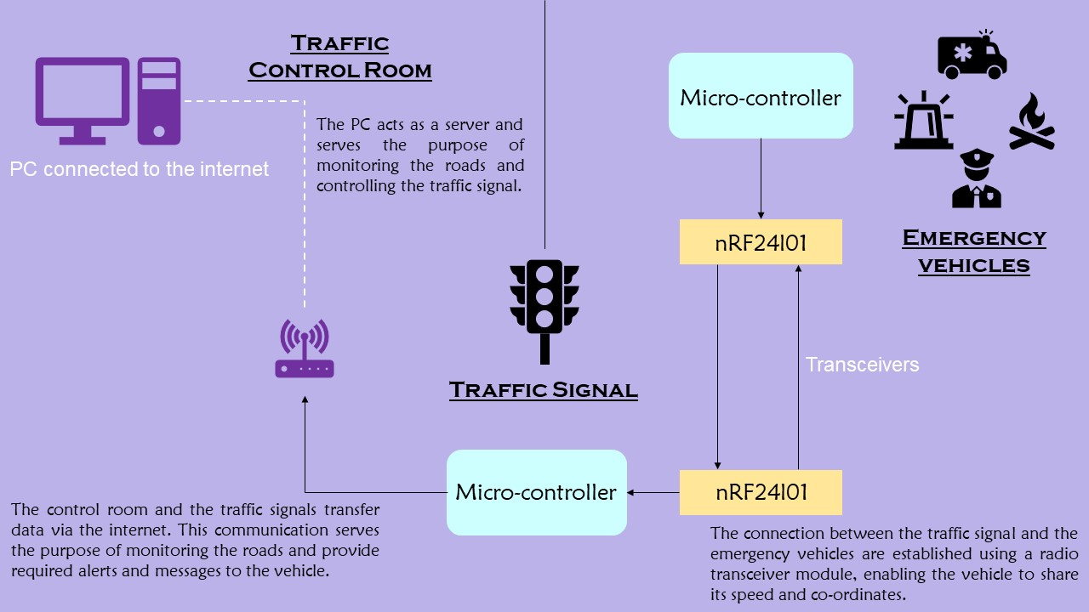
WORKING PRINCIPLE

Slide 9
COMPONENTS OVERVIEW
ARDUINO UNO – A powerful tool enabling us to test the software solution and prototype.
NRF24L01 – Operates in 2.4GHz frequency and the data transfer can achieve speed of 2 MBPS.
Raspberry Pi - a small single-board computer
GPS module ( NEO 6m ) – A strong GPS receiver with ceramic antenna.

Slide 10
FLOWCHART
Start
Approaching junction
Periodically send EPR
EPR granted
Yes
Slowdown and pass the junction
Move towards junction
No
Crossed junction
Yes
Junction crossed message
Junction crossed message
END
Junction crossed message

Slide 11

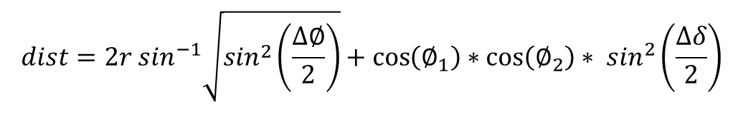
LET’S DO SOME MATH
Haversine formula – Distance between two points on earth surface
$$dist=2r \sin^{−1}\sqrt{\sin^{2}\left(\frac{∆∅}{2}\right)}+\cos\left(∅_{1}\right)∗\cos\left(∅_{2}\right)∗ \sin^{2}\left(\frac{∆δ}{2}\right)$$
Example:
Sitra to Coddisiya
Sitra = 11.0371 deg North, 77.0368 des East
Coddisiya = 11.0421 deg North, 77.0263 East
Distance = 2.564 km
Coddisiya to Hopes
Hopes = 11.0268 deg North, 77.0197 deg East
Distance = 1.036 km

Slide 12





SOCIO-ECONOMIC IMPACT
Fuel
Cost
Life
Time

Slide 13

REFERENCE
https://ieeexplore.ieee.org/stamp/stamp.jsp?arnumber=8523674
Predicting Ambulance Demand: Challenges and Methods
A COMPREHENSIVE SURVEY ON THE AMBULANCE ROUTING
AND LOCATION PROBLEMS
Analysis of Low Cost Communication Technologies for V2I Applications

Slide 14

Thank you

